Slide 1
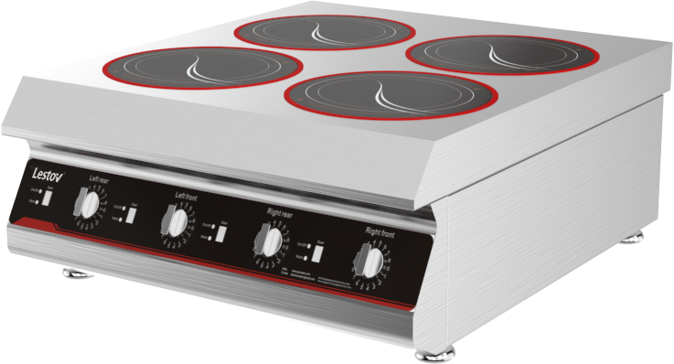
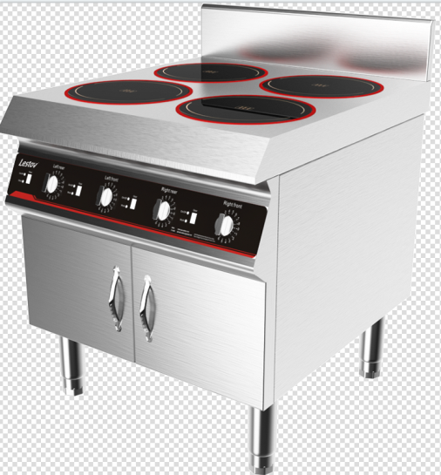
Commercial Induction 4 Burners
Model No. | Power Voltage | Product Size | Material
LT-TBZ300Ⅳ-B13 | 3KW*4 /230V/50Hz | Glass￠300·Heat￠210mm L700*W800*H330mm | SS304
LT-B300IV-B13 | 3KW*4 /230V/50Hz | Glass￠300·Heat￠210mm L700*W800*H800+150mm | SS304
Power/Frequency: 3Kw*4burner /50-60Hz
Voltage: 230V 1 phase
Flexible wiring method : 230V
Glass thickness: 6mm
Maximum glass load： ≦ 100KG
Heating area:￠210mm
pan suitable material: Cast Iron
Working environment: Humidity 30%-90% ; Temperature -5℃-40℃
Application : cafes bar, bakery, food truck, traveling food stalls and fast food restaurant.
💥 Induction heating technology 1)Up to 92% thermal efficiency 2)40% energy saving than gas operated 3)High frequency coil ,no blind heating area 💥 Easy operation 1)4 burners working independently 3) 360˚ Knob switch & 8 power rating 4) Built-in safety protection and error code display system 5) Fully mould 304 SUS ,easy clearing 💥 Safety & ECO –friendly 1) no open fire & no fire hazard & no smoke & no Grease & Odor free 2) Reduce temperature & noise & Enhance working environment

Slide 2
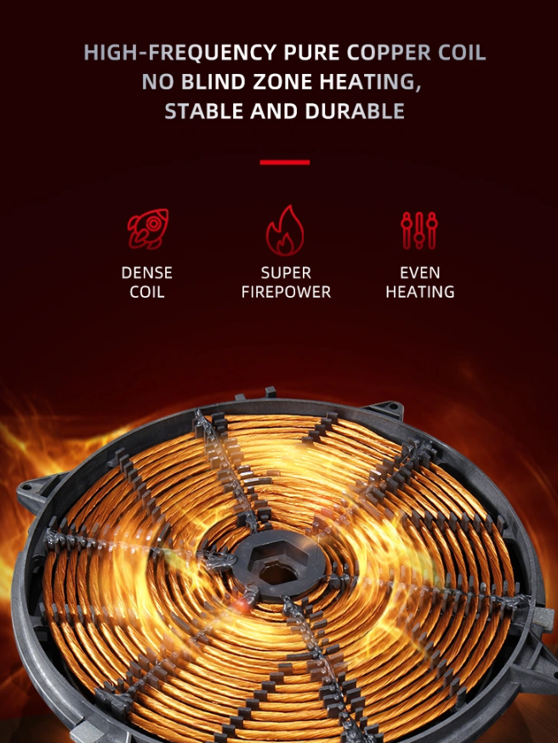
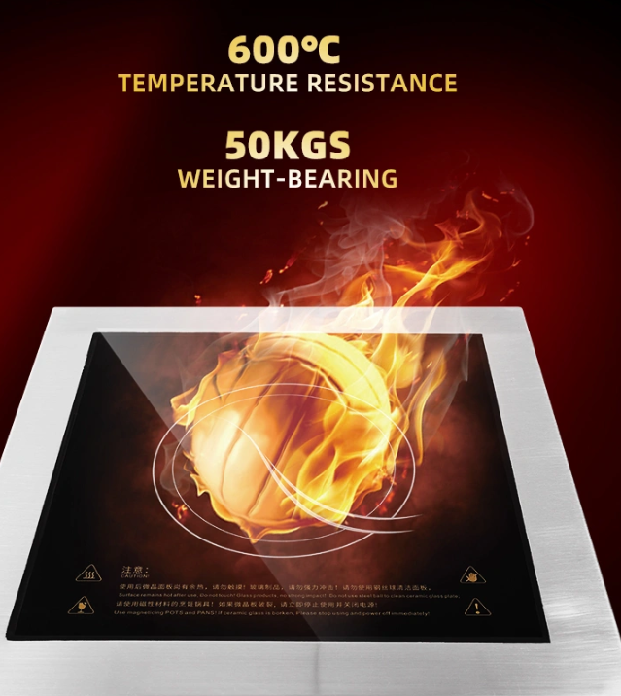
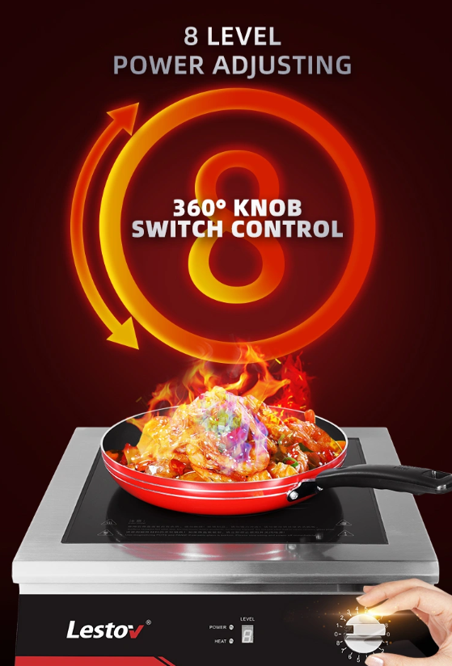
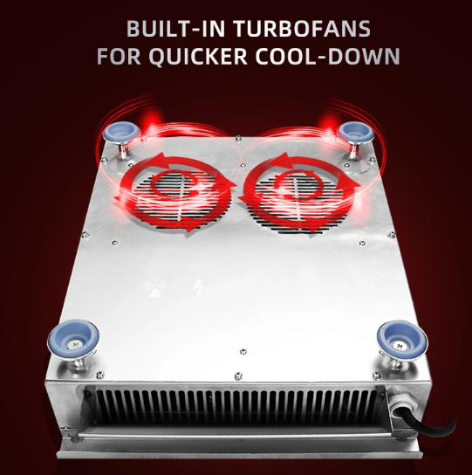
Component of Commercial Induction 4 Burners
Anti-Slip foot design

Slide 3
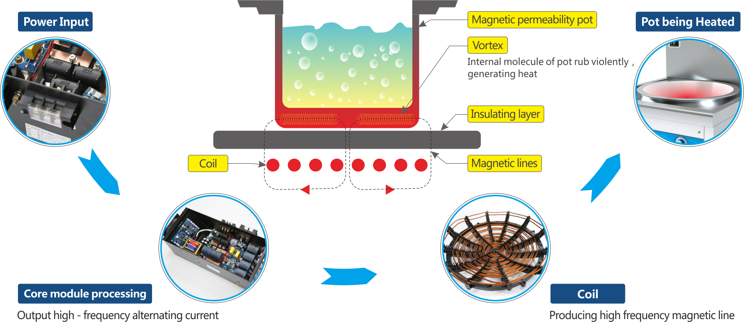

Slide 4
